Slide 1
Feature Engineering

Slide 2
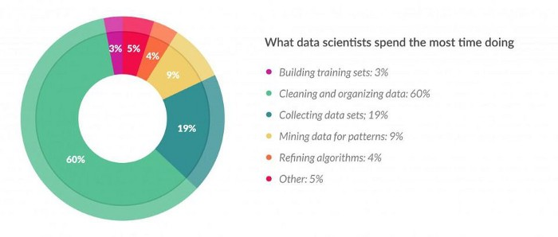
https://www.forbes.com/sites/gilpress/2016/03/23/data-preparation-most-time-consuming-least-enjoyable-data-science-task-survey-says/#1594bda36f63

Slide 3
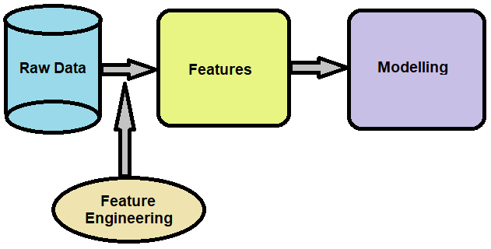
Feature Engineering
is a procedure involving an implementation of data’s domain knowledge for generating features making machine learning algorithms workable
https://analyticsindiamag.com/introduction-to-feature-engineering-and-its-techniques-for-machine-learning/
https://www.analyticssteps.com/blogs/feature-engineering-method-machine-learning

Slide 4
Reduce Complexity
Step of Feature Engineering
Importance Feature Engineering
Data Preparation
Exploratory Analysis
Increase Accuracy
Benchmarking
https://www.analyticssteps.com/blogs/feature-engineering-method-machine-learning

Slide 5
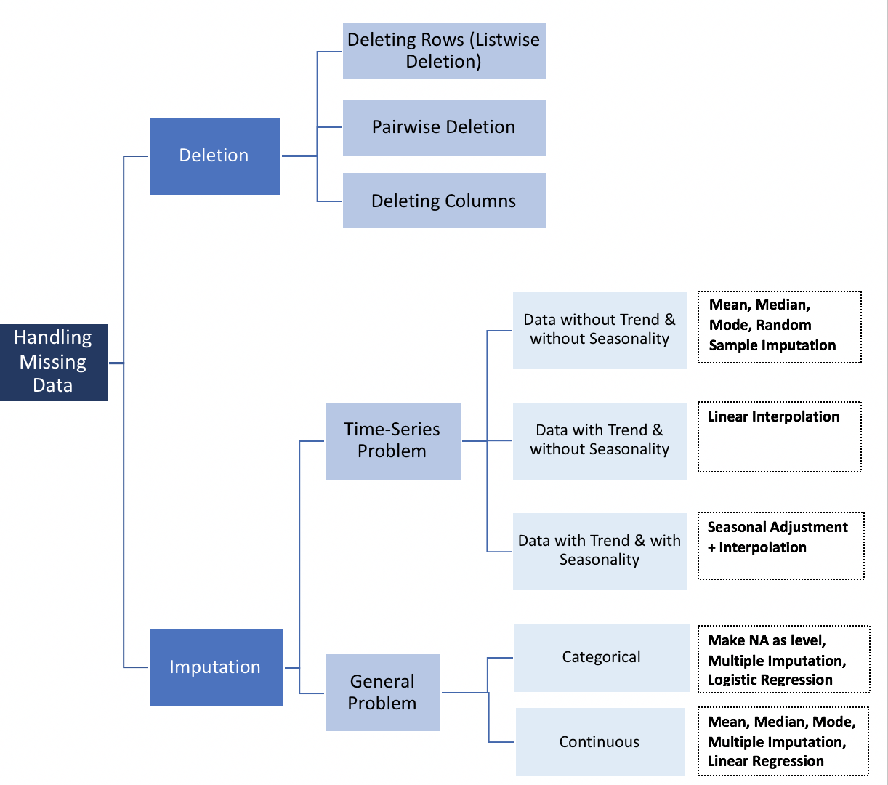
Handling Missing Data
Missing Completely at Random (MCAR)
Missing at Random (MAR)
Missing Not At Random (MNAR)
https://onlinelibrary.wiley.com/doi/book/10.1002/9781119013563
https://towardsdatascience.com/how-to-handle-missing-data-8646b18db0d4

Slide 6
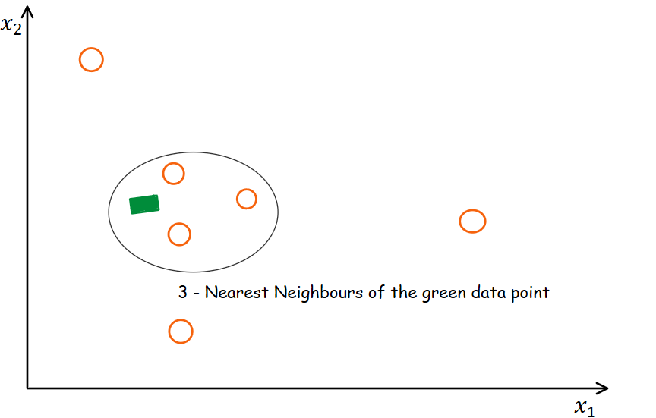
K-NN Imputer
One popular technique for imputation is a K-nearest neighbor model. A new sample is imputed by finding the samples in the training set “closest” to it and averages these nearby points to fill in the value.
Applied Predictive Modeling, 2013.
https://www.analyticsvidhya.com/blog/2020/07/knnimputer-a-robust-way-to-impute-missing-values-using-scikit-learn/

Slide 7
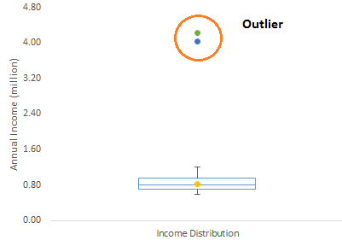
Handling Outliers Data
Detect Method | Requirement
Z-Score | Parametric Data, Normal Distribution, small to medium data
Probabilistics & Statistical Model | Parametric & Skewed data
Linear Regression | PCA
Proximity Based Models | Non-parametric
DBSCAN | Distribution not assumed & multidimensional data
Isolation Forest | No need scaling data
Outliers are the values that look different from the other values in the data.
http://colingorrie.github.io/outlier-detection.html
https://towardsdatascience.com/a-brief-overview-of-outlier-detection-techniques-1e0b2c19e561
https://towardsdatascience.com/outlier-detection-methods-in-machine-learning-1c8b7cca6cb8

Slide 8
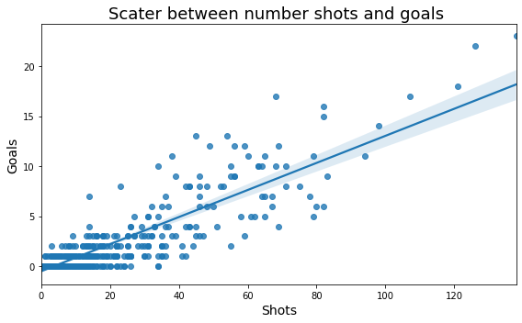
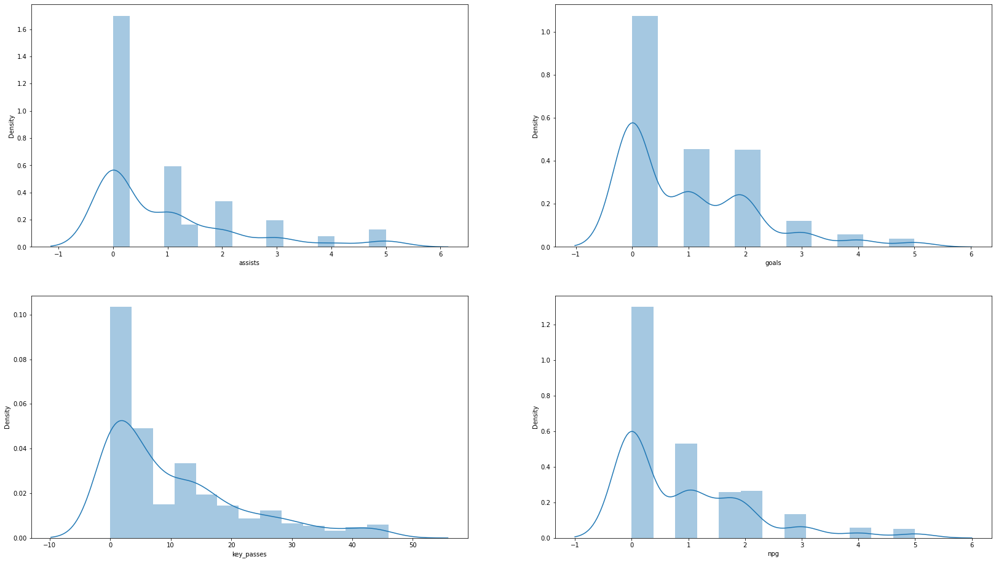
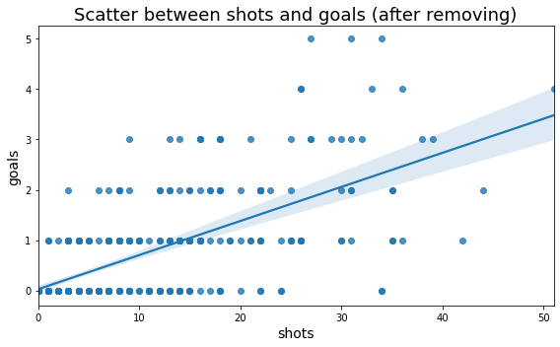
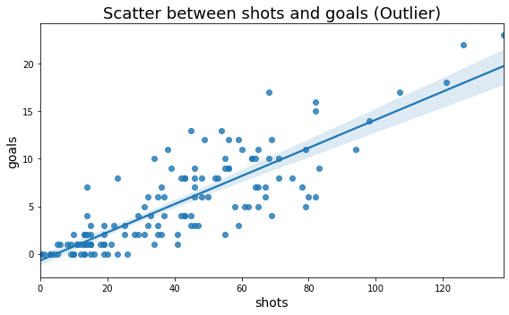
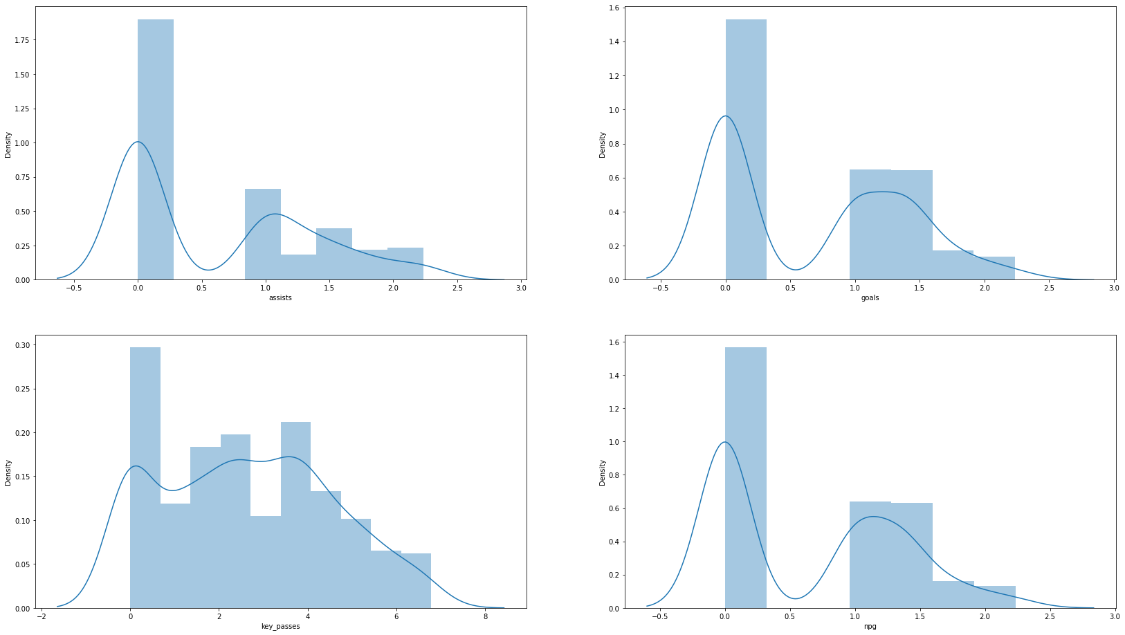
Separately Treating
Transformation
https://medium.com/analytics-vidhya/detect-and-handling-outliers-53723d8ec17a

Slide 9
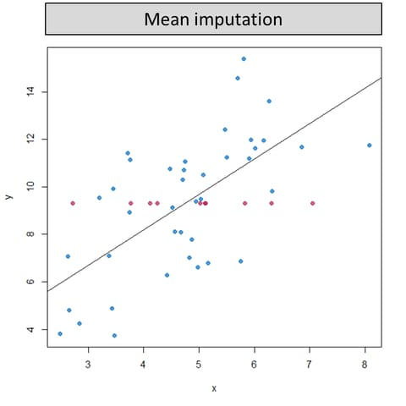
Cut Outliers
Imputation
https://medium.com/analytics-vidhya/detect-and-handling-outliers-53723d8ec17a

Slide 10
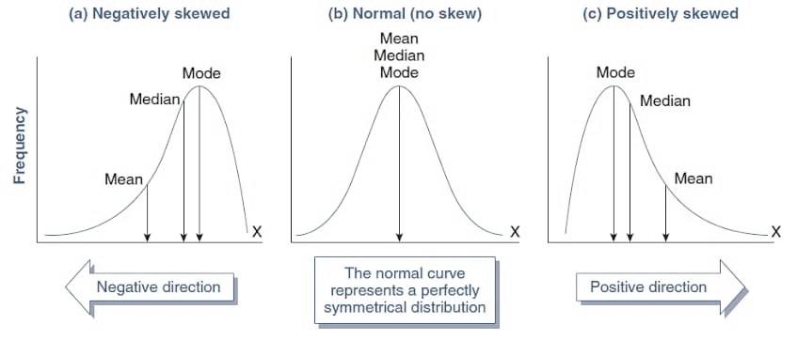
Scalling Data
“is a common practice in machine learning which consists of transforming numeric columns to a common scale”
Normalization
Process of scaling in respect to the entire data range so that the data has a range from 0 to 1
Standardization
Process of transforming in respect to the entire data range so that the data has a mean of 0 and a standard deviation of 1.
Tranformation
The application of the same calculation to every point of the data separately
https://medium.com/analytics-vidhya/a-guide-to-data-transformation-9e5fa9ae1ca3
https://towardsdatascience.com/data-normalization-with-pandas-and-scikit-learn-7c1cc6ed6475

Slide 11


Standardization | Normalization
Z-score Method | Min-Max Scaling
Transformation | Heavy Tailed Data | Negative Skewed Data
Positive Skewed Data | Heavy Tailed Data | Negative Skewed Data
Root Tansformation | Median Subtract | Square Transformation
Log Transformation | Lamber x Gaussian Transform | Eksponensial Transformation
Reciprocal Transformation | Boxcox Transformation (linear Data)
 | Tukey Transformation (close normality data)
https://towardsdatascience.com/data-normalization-with-pandas-and-scikit-learn-7c1cc6ed6475
https://medium.com/analytics-vidhya/a-guide-to-data-transformation-9e5fa9ae1ca3

Slide 12
THANK YOU

